Slide 1
Artificial intelligence–enabled electrocardiogram to
distinguish atrioventricular re-entrant tachycardia
from atrioventricular nodal re-entrant tachycardia
28 May 2024
Andrea Corrado

Slide 2
Background
Within the possible forms of supraventricular tachycardia (SVT) it is possible to recognize atrial tachycardia (AT), atrioventricular re-entrant tachycardias (AVRT), and atrioventricular nodal re-entrant tachycardias (AVNRT).
While distinguish between AT and AVRT/AVNRT is usually not so difficult because can be done looking at the number of P waves respect to the number of QRS in the ECG signal, distinguish between AVRT and AVRNT is a complex problem, requiring an electrophysiology (EP) study.
The aim of the presented work is to find a way to accurately determining arrhythmia mechanism from a 12-lead electrocardiogram (ECG).
To do it, a CNN is trained for the specific task of differentiating AVRT and AVRNT.

Slide 3
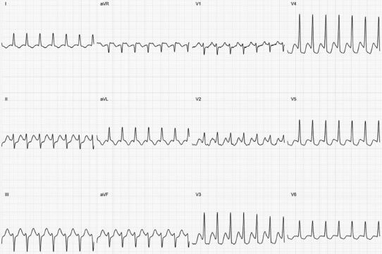
Material and methods [1/3]
Dataset (retrospective study)
155 with AVRT or AVNRT (pre-ablation) and not other type of arrhythmia. Only one 12-lead surface ECG record for each patient, sampled at 1000Hz.
12-lead surface ECGs were manually labelled using the diagnosis made when they were recorded.
Training set:
1 to 5-minute ECG records split into 5-seconds segments.
Resulting in 4921 records from 124 patients.
Test set:
One 5-second segment for each patient .
Resulting in 31 records
Preprocessing:
Conversion in time series data
Down sampling at 200Hz
Example of ECG showing atrioventricular
re-entrant tachycardia

Slide 4
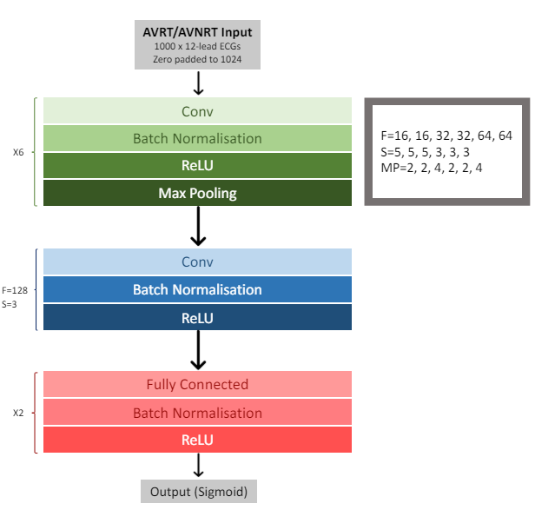
Material and methods [2/3]
Model architecture
Training strategy
Learning rate: 0.01
Binary cross entropy loss function minimized using Adam optimizer
40 epochs with early stopping
Bach size of 16, no dropout
Training phase split into 2 parts (see next slide):
Hyperparameter tuning on training-validation split of 80-20%
10-fold cross validation → ensemble (average) model

Slide 5
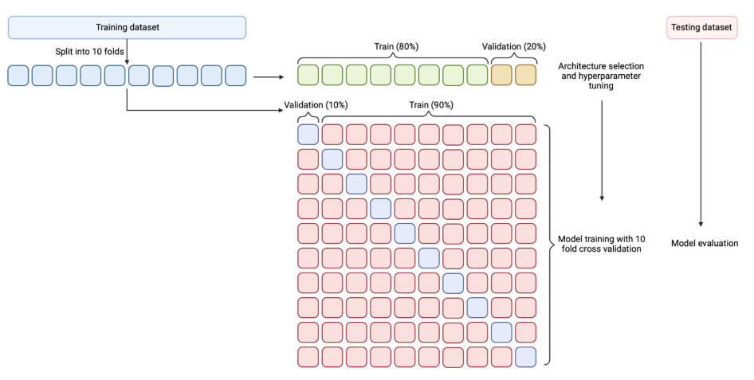
Material and methods [3/3]

Slide 6
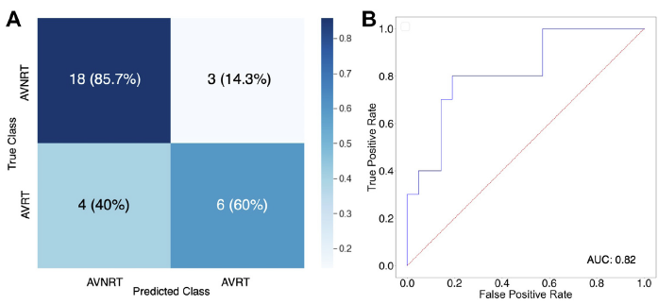
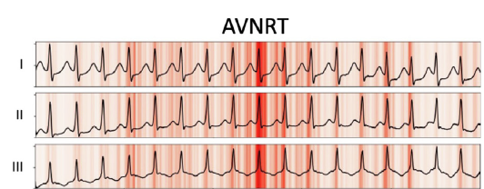
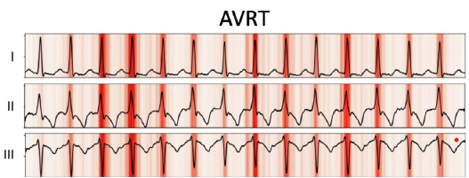
Results
Model performances
Accuracy: 77.4%, F1-score: 0.63
AUC of 0.82 (threshold of 0.5)
Saliency mapping suggestion about the outcome:
The QRS in each case appears to be salient; this may relate to the presence and timing of retrograde P waves in the QRS complex and is biologically plausible.

Slide 7
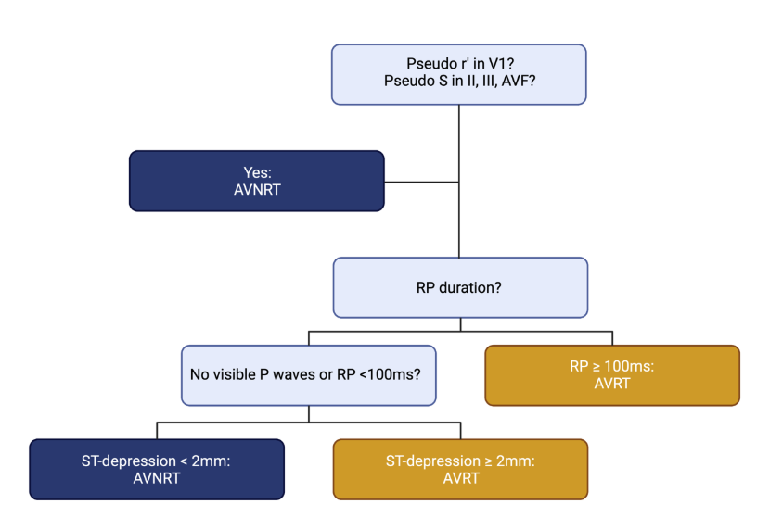
Conclusions
The presented work is the first deep-learning model trained to distinguish between AVRT and AVNRT using only 12-leads surface ECG signals.
It’s a step forward compared with the previous algorithm
Comparison with Jaeggi and colleagues algorithm (on the right) tested on the same dataset → accuracy of 67.7%
the improvement is not statistically significant because of the dataset size.
The study has some limitations:
the dataset size, probably related to the lower performances on AVRT classification,
The origin of the data were a single medical center
The input of the model is made of only AVRT/AVNRT examples

